Slide 1
What is violence?
Pre-workshop tutorial material

Slide 2
Teacher information- This slide needs to be removed if using this as a presentation prior to the lesson
This session is designed to be used in a tutorial and should last approximately 20 mins.
It is hoped to generate discussion about acts of violence that would lead into our anti-violence workshop.
Slides 3-7 are for information and give violent crime statistics and definitions of some of the various forms of violent crime relevant to our workshop.
Slide 8 is an activity where pupils need to justify their reason for allocating a crime type. Most are self explanatory but slide d has been included specifically to generate discussion as to whether the victim has been pushed or just threatened- would this be common assault and when might it be affray?

Slide 3
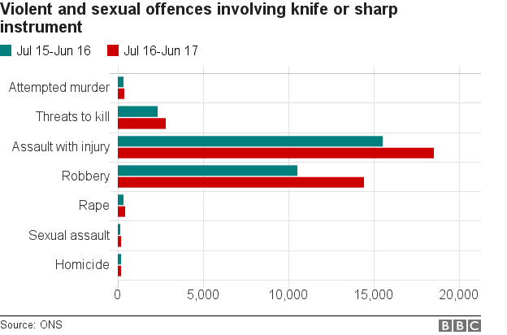
During recent years the number of violent crimes has steadily risen in England and Wales. Now more people than ever are being affected by violence.
http://www.bbc.co.uk/news/uk-41677046

Slide 4
What does this look like?
Since 2017 :
Whilst overall crime continues to fall, violent crime has risen by 19% and knife crime by 17%.
Last year there were :
1.4 million incidences of violence in England and Wales with
60% of these incidents involved young people and assault the second leading cause of hospital admissions for males aged 15-24.
This is the highest level for more than five years with young people below the age of 26 years most likely to be a victim or perpetrator.
Office of National Statistics, 2018

Slide 5
So what constitutes violence?
VIOLENCE is defined as :
Any situation where someone uses violence or threatens to use violence against a victim. Violence can be part of a number of different crimes including robbery, assault and gang crime. Recently, acid attacks have been used as a form of violence specifically throughout London.
http://voicenorthants.org/cyp/advice/violence/assault-advice-11-15-year-olds/

Slide 6
Lets break that down a bit and consider what it means and what happens to those committing the crime….
ROBBERY
Robbery is when you use or threaten to use force to steal and is considered more serious than theft. Sentencing for robbery is dependent on the type of robbery committed. For example; committing a violent robbery using a weapon would mean that you would receive a much longer sentence.
For help go to https://www.victimsupport.org.uk/crime-info/types-crime/robbery
ACID ATTACK
Acid attacks are a violent assault on victims and leave devastating injury. Acid is thrown onto the victim with one purpose to injure, harm and maim. This type of attack is often used as a way of showing dominance, power and control. The intention of this type of attack is for someone to live with the injuries caused for the rest of their lives. If you carry out an acid attack you could face life imprisonment.
For help go to http://www.asti.org.uk/
gANG CRIME
A gang can be a group of friends that all like doing the same things. The word takes on a new meaning when a group of friends gets involved in criminal activity. Although it is not illegal to be a member of a gang, much of the activity that criminal street gangs get caught up in is for example – drug dealing, violence and abuse.
For help go to http://www.youandco.org.uk/crime-info/violent-crime-facts/gangs-and-street-violence

Slide 7
Assault is a general term used to describe when someone physically attacks you, or threatens to attack you. But in practice it is sub divided into several categories according to the severity of the attack.
COMMON ASSAULT- 1 :1
Common assault is when you are violent or cause someone to fear violence e.g. hitting them or threatening them. You don’t actually have to physically assault someone to be charged with common assault. Sentencing could mean six months in prison or a fine up to £5,000.
http://www.youandco.org.uk/crime-info/violent-crime-facts/what-assault
AFFRAY( often multiple people involved)
Is a public order offence and you could be found guilty if you have used or threaten to use violence towards another and if your behaviour cause's people present at the scene to fear for their personal safety. The maximum penalty is 3 years' imprisonment and/or a fine.
ABH (Actual Bodily Harm)
is assault when you cause someone actual bodily harm for example breaking someone’s nose or causing bruising. The maximum sentence for ABH is 5 years.
http://www.youandco.org.uk/crime-info/violent-crime-facts/what-assault
GBH (Grievous Bodily Harm)/serious assault - means you’ve caused someone serious injury, e.g. a broken bone or stab wound. It’s more serious than ABH and means you could receive a life sentence if found guilty.
Definitions taken from: https://www.fearless.org/en

Slide 8
GBH
Stabbing
Breaking bones
punching
Most Severe
ABH
Shoving
biting
The Assault Scale
Affray
Threatening to use violence
Common assault
Spitting
Slapping
shoving
Least Severe

Slide 9
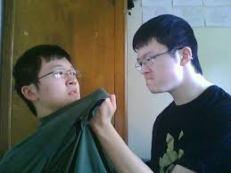
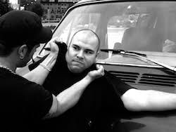
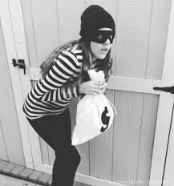
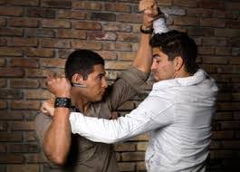
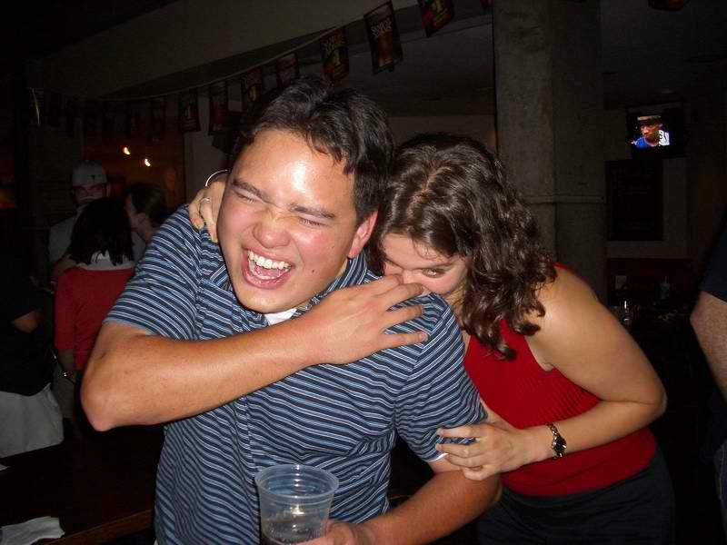
In pairs- decide what crime is/has been committed here and what sort of sentences can be expected – give your reasons
a
d
g
b
e
h
c
f
i

Slide 10
Don’t Stand by ….Report it!
Websites to help you have been included throughout but If you witness any of these crimes being committed you can report it directly to the police by dialling 999, visiting your local police station or anonymously via the website
https://www.fearless.org/en

